Slide 1

From Data Science to Production
With Kotlin

Slide 2
Course Mission
Present Kotlin as a platform to seamlessly integrate the entire data science supply chain, from ETL (Extract-Transform-Load) to DAD (Discover-Access-Distill), and finally to production.
From Data Science to Production with Kotlin will cover the fundamentals of the Kotlin language, while Practical Data Modeling for Production with Kotlin will expand on advanced features and practical applications.

Slide 3
Agenda
Why Kotlin for Data Science?
Setup
Kotlin Basics
Flow Control and Classes
Collections
Course is continued in Practical Data Modeling for Production with Kotlin.

Slide 4
Section I
Why Kotlin for Data Science?

Slide 5
What is Kotlin
Kotlin is a JVM language (meaning it runs on the Java platform) that focuses on pragmatism and industry.
Think “Scala for Dummies”, as it takes the practical features of modern languages and rids the academic features.
Created by JetBrains, the creator of Intellij IDEA, PyCharm, and dozens of other developer tools.
Released in 2016 after 5 years of careful planning, development, and testing.
100% compatible with all Java libraries (including Apache Spark), giving it a strong existing ecosystem.
In 2017, Google backed Kotlin as the official language for Android, effectively making it a replacement for Java.
Between Google and JetBrains’ long-term commitment, it is clear Kotlin has a bright future and is poised to take on multiple technology domains.
Kotlin is also positioning itself beyond the JVM, including JavaScript and LLVM.

Slide 6
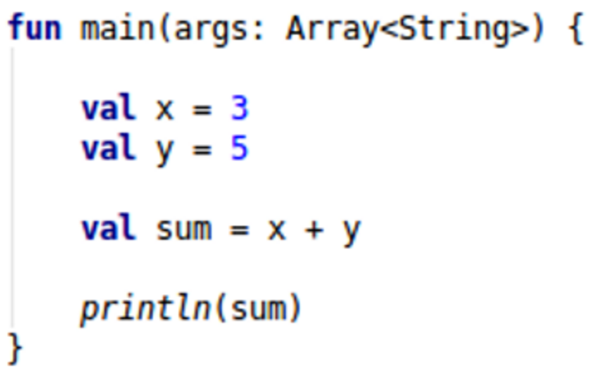
What Does Kotlin Look Like?

Slide 7
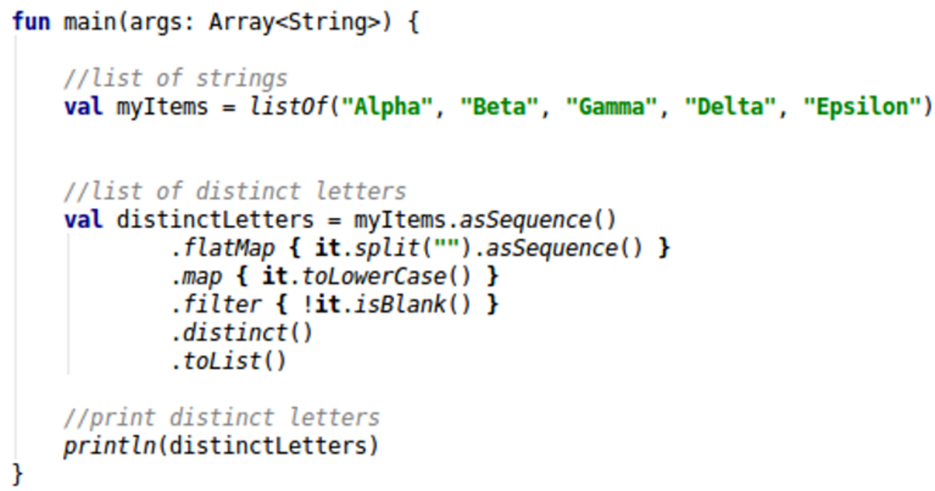
What Does Kotlin Look Like?

Slide 8
Why Kotlin for Data Science?
There are several programming languages and platforms already used on the data science domain:
Python
R
Scala
Julia
These platforms are effective and add value, but do they close the gap between data science, data engineering, and software engineering?
ETL and model code often needs to go into production to be useful, and must be compatible with existing corporate IT systems.
The code then needs to refactor and evolve with the business, without breaking down and introducing bugs.
This all needs to happen while keeping code concise, tactical, and business-focused.
Recommend reading: https://www.oreilly.com/ideas/data-science-gophers
Kotlin can close this gap effectively and work well in existing corporate systems.

Slide 9
Kotlin vs. Python
Python is a powerful, flexible platform with a simple syntax and rich ecosystem of libraries.
Dynamic typing makes Python flexible for ad hoc analysis, but it can quickly backfire in production.
Dynamic types allow improvised data structures to be defined at runtime.
Dynamic typing can quickly create difficulties in maintaining and debugging codebases.
Larger Python codebases can be difficult to understand and maintain.
Kotlin, like Scala, embraces immutability and static typing.
Data structures are explicitly defined and enforced at compile time, not runtime.
While static typing is traditionally verbose, Kotlin manages to make it concise in a Pythonic manner.
Kotlin may not have as many mainstream data science libraries like Python, but it has comparable ones in the Java ecosystem:
Apache Spark
ND4J
Apache Commons Math
Weka
Java-ML

Slide 10
Kotlin vs Scala
Kotlin and Scala have an interesting relationship:
Many view Kotlin as an evolution of Scala, taking its most useful features and simplifying them.
Kotlin attempts to be less esoteric than Scala, and use familiar constructs that are easy to read.
Kotlin selectively innovates out of need (e.g. nullable types) while Scala experiments with features more liberally.
Kotlin also works with JVM libraries (like Apache Spark) out of the box, demonstrating Scala, Java, and Kotlin can work compatibly together to accommodate people's needs.
In a nutshell...
Kotlin is designed ground-up for industry, while Scala has roots in academia.
If you are happy with Scala, you will likely not need Kotlin.
If you tried Scala and it was not for you, give Kotlin a try.

Slide 11
Kotlin vs Other Languages
Java is reputably verbose (even with Java 8 lambdas).
Java is often difficult to turnaround code quickly, which marginalizes its utility in data science.
Legacy compatibility often constrains the number of features it has as a language.
R excels at math, and is not a general programming language like Kotlin, Python, Scala, or Java.

Slide 12
Section II
Setting UP

Slide 13
What You Will Need
You will need to download and install the following to develop with Kotlin:
Java JDK – Platform to build JVM applications
http://www.oracle.com/technetwork/java/javase/downloads/
Intellj IDEA Community Edition – IDE for Java, Kotlin, and Scala
http://www.jetbrains.com/idea/download/

Slide 14
Configuring Intellij IDEA
When you create a new project with Intellij IDEA, select the “Maven” option
You will need to tell Intellj IDEA where the JDK is you installed
Click the “New” button to browse for the JDK folder’s installation location

Slide 15
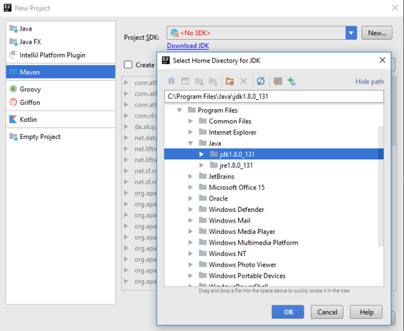

Slide 16
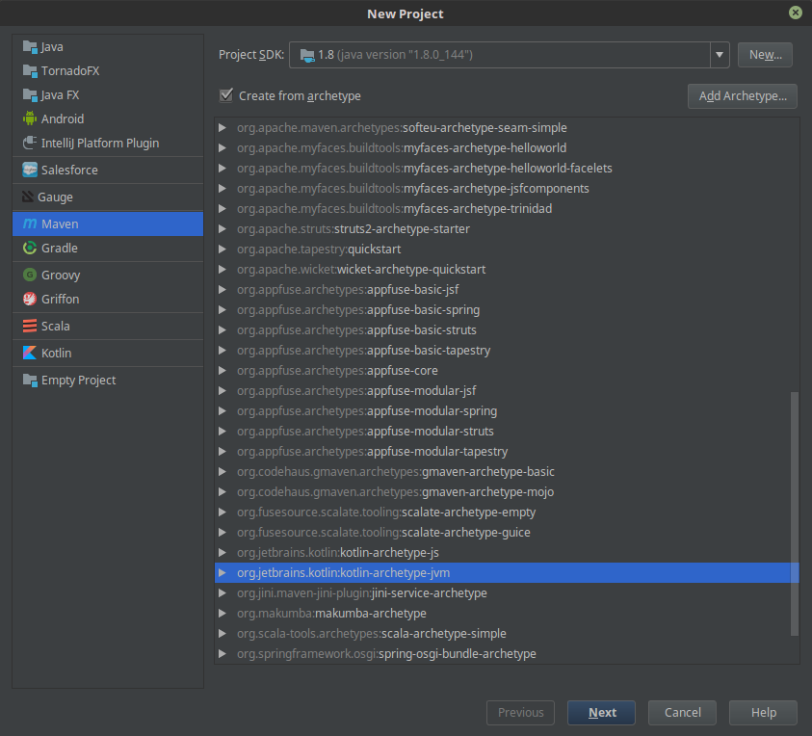
Create a new Project
Make it a "Maven" project
Select a "kotlin-archetype-jvm" to use a template
Hit "Next"

Slide 17
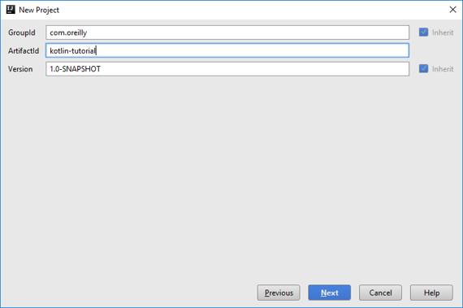

Slide 18
Section III
Kotlin Basics

Slide 19
Basic Data Types in Kotlin
Type​ | Literal​ | Description​
Int​ | 23​ | A whole integer, with a range of ± 2³¹​
Long​ | 2323742L​ | A whole integer, with a range of ± 2⁶³​
Double​ | 52.23​ | Common decimal type​
String​ | “Foxtrot”​ | A series of text characters​
Boolean​ | true​ | A true or false value​
BigDecimal​ | BigDecimal(180.32)​ | High precision decimal, use for money​
LocalDate​ | LocalDate.of(2017,3,5)​ | A simple date, no timezone​
LocalTime​ | LocalTime.of(7,55,30)​ | A simple time, no timezone​
LocalDateTime​ | LocalDateTime(2017,3,5,7,55,0)​ | A simple date and time, no timezone​

Slide 20
Operators in Kotlin
Operator​ | Description​
+​ | Adds two items​
-​ | Subtracts two items​
*​ | Multiplies two items​
/​ | Divides two items​
%​ | Divides two items, but returns the remainder..​
..​ | Generate a range between two items​
== and !=​ | Returns a boolean indicating equality and inequality​
<, >, <=, >=​ | Comparative operators, returns a boolean​
in and !in​ | Determines if an item contains/doesn’t contain another item​
++ and --​ | Increments an item, decrements an item​
+= and -=​ | Same as above, but assigns new value back​ to variable

Slide 21
Section IV
Flow Control and classes

Slide 22
Features of Data Classes
A concept of equality to see if two instances of data classes are equal based on their properties
A toString() implementation that displays the contents of the object
A copy() function that allows you to create new objects off the old one, and change certain properties.
componentN() functions that numerically correspond to each property.

Slide 23
Going Forward
This is the end of From Data Science to Production, with Kotlin.
Please follow up with the next video series Practical Data Modeling for Production, with Kotlin, which includes topics such as:
Working with data sources (text files, SQL, web requests)
Functional programming with Kotlin
Adapting Kotlin to your Domain
Practical Applications of Kotlin for Data Science
Different data science and engineering libraries for Kotlin
Get plugged into the Kotlin community: http://slack.kotlinlang.org/

Slide 24
Resources
Kotlin Official site (http://kotlinlang.org/)
Kotlin Reference (http://kotlinlang.org/docs/reference/)
Kotlin Slack Community (http://slack.kotlinlang.org/)
O’Reilly Introduction to Kotlin Programming (https://goo.gl/zaxztZ)
O’Reilly Advanced Kotlin (https://goo.gl/azU9Fp)
Manning Kotlin in Action (https://goo.gl/1LQHos)

